Slide 1



Slide 2

Leader in the distribution segment in Brazil, we operate in
Smartphone, Games, IT, Electronics and Smarthome division.
With a focus on bringing new lines to increase categories in retail.
We are focused on developing solutions, for 22 years we are delivering technology throughout Brazil, with a unique and
intelligent operating model.

Slide 3




Slide 4
We serve from small retailers to large wholesalers
More than
28.000
POS covered.
4 Million
products sold in 2023

Slide 5

Rcell Team
Formed by more than
300
specialists
dedicated to the
development of your business.

Slide 6








Business Management
Logistics
Administrative
Information
Technology
Time Rcell
Project Development
Usability
Marketing
Web Solutions

Slide 7
2002
Foundation
Sony Ericsson
2005
2007
LG
Timeline
Nokia
2010
2011
Motorola
Samsung
Sony Playstation
2012
2014
Webfones
Marketplace Asus
2015
Nova sede – CENU SP Compliance
2019
Web Mercadinho Incomm
Nintendo
Rsmart
2020
Divisão Consumer Electronics
2021
D-Link
Raveo
2022

Slide 8
2002
Fundação
Sony Ericsson
2005
2007
LG
Nokia
2010
2011
Motorola
Samsung
Sony Playstation
2012
2014
Webfones
Marketplace
Asus
2015
New Headquarters– CENU SP
Compliance
2019
Web Mercadinho Incomm
Nintendo
Rsmart
Timeline
2020
Consumer Electronics Channel
2021
D-Link
Raveo
Qualcomm-Snapdragon
2022
Innovation Channel
2023

Slide 9















Departments
Telephony Accessories
Air Conditioning
Audio
Health and Beauty
Cables/ Charges/
Headphones/ Stands
Air Conditioners/ Fans/ Air
Purifiers
Speakers/ Soundbar
Hair Brush/ Dryers/ Flat Iron/
Hair Trimmer
Home appliances
Small appliances
Tools
Games
Microwaves/ Refrigerators/
Washers/ Range Hoods
Mixers/ Fryers/ Blender/ Iron
Drills/ Saws/ Screwdriver
Games/ Consoles/
Accessories
Computers
Cleaning
Smarthome
Cell Phones
Notebooks/ Printers/
Modem/ Monitors/ Tablets
Vacuum/ High Pressure
Washers/ Mop/ Extractors
Smart Bulbs/ Smart Plugs/
IR Remote Controller/
Smart Door Lock
Smartphones/ Pre-owned
Video
Wearable
Smart TVs/ Projectors
Smartwatches

Slide 10

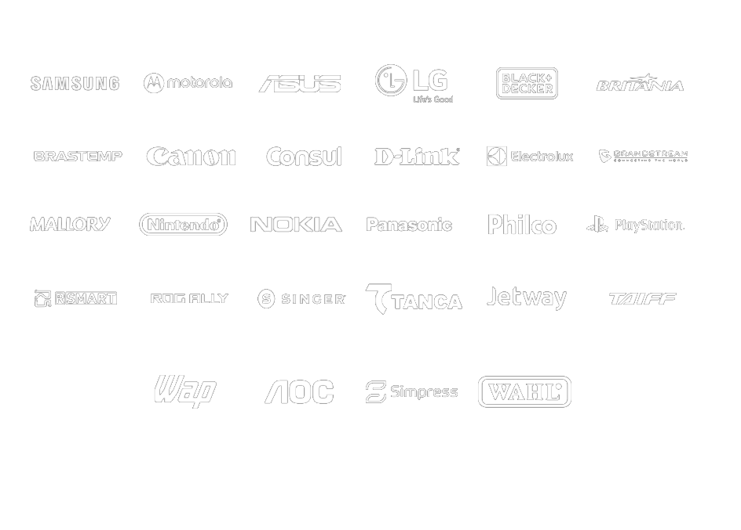
Brands

Slide 11


409th company in the Wholesale and Foreign Trade category of 2022, according
to Valor1000.

Slide 12
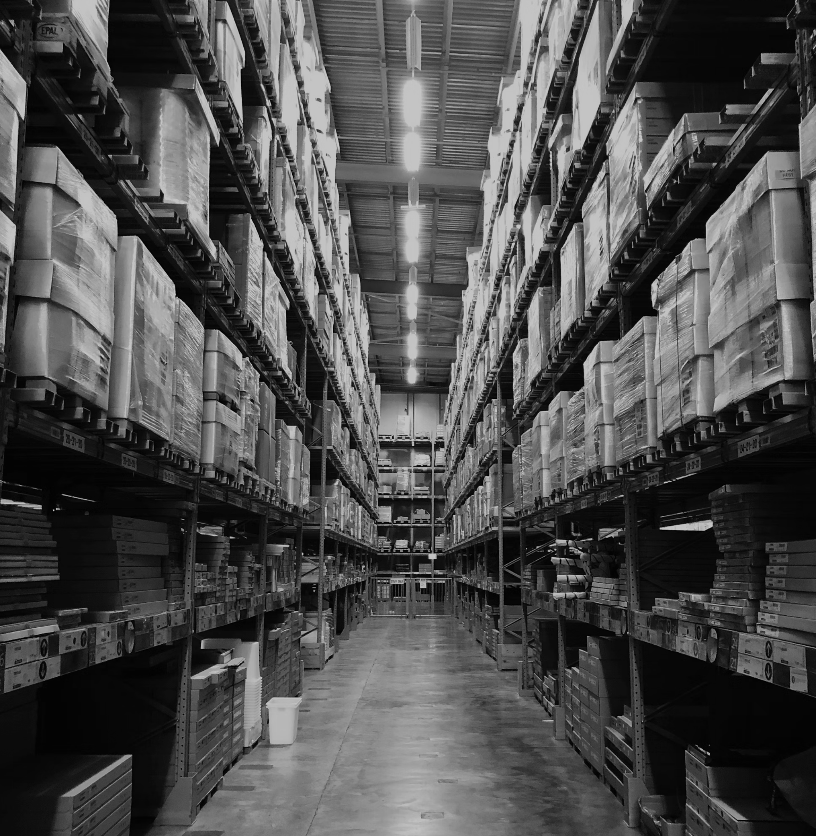
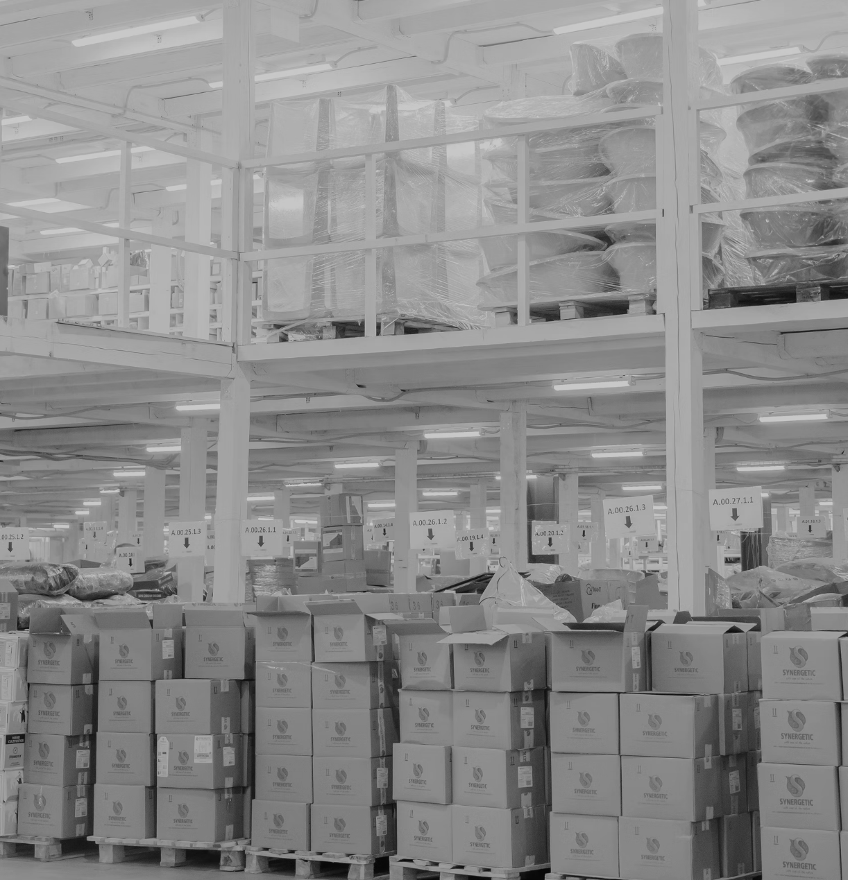
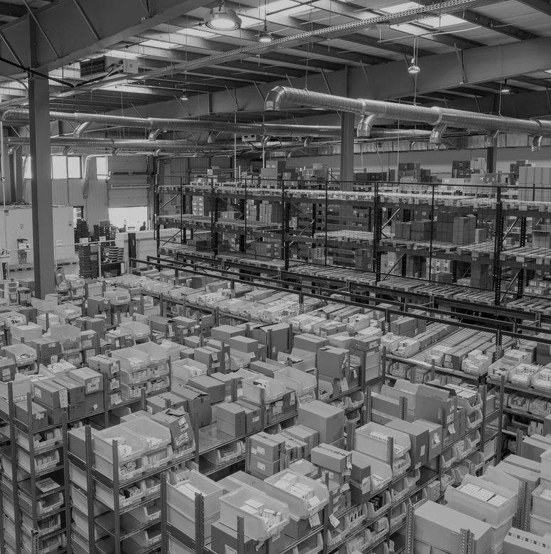
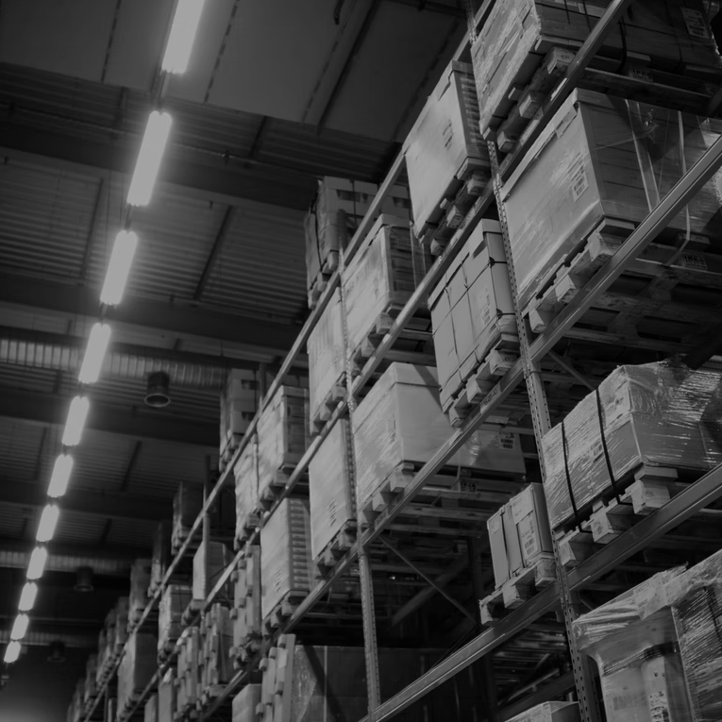



Structure
4 CDs - Presence throughout the National Territory for a faster logistic process.
SP – LAPA .
Logistics Agility
SP - BARUERI .
SC - ITAJAÍ .
Tax Efficiency
Proximity
ES - VITÓRIA .
Smart Supply

Slide 13







Online Channels
Website
Loja Rcell
Blog
Youtube
Access center to other
platforms
Online B2B sales channel.
News and information on technology
and the business world.
Sharing of institutional
videos.
Linkedin
Instagram
Facebook
Email Marketing
Propagation of job
opportunities and news.
Over 8.000 followers.
Over 29.000 likes.
Over 16.000 contacts.

Slide 14


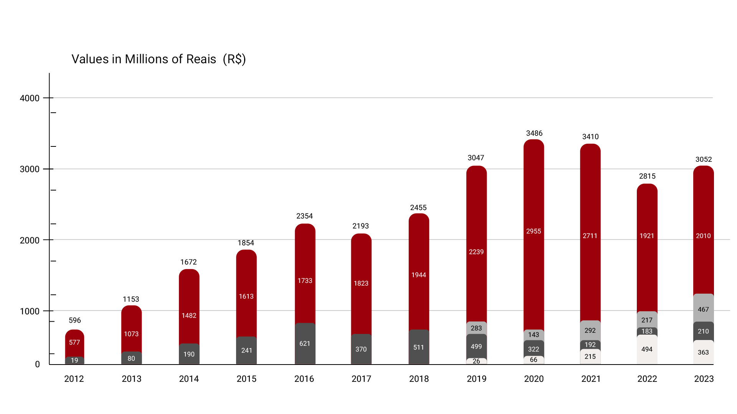
Annual Billing by Department
Smartphones
Games
Computers
Consumer Electronics

Slide 15

11%
11%
15%
North
Midwest
North East
Billing by Region
22%
41%
South
South East
% of billing by region(2023)

Slide 16



Market Share | Smartphones
Smartphones General Market
Smartphones Distribution
Rcell has a 8% share of the overall Smartphones sales market in the country, and dominates 53% of the handset distribution market.
General Market(92%)
Other Distributors (47%)
Rcell (8%)
Rcell (53%)

Slide 17




Rcell vertical, dedicated exclusively to the corporate market.
This business channel focuses on the development of personalized solutions, offering support in corporate projects, analysis of notices and active participation in Proofs of Concept (PoC).
Rcell Corporate's efficiency is reinforced by its specialized technical team, made up of professionals with extensive experience in corporate solutions.
Always up to date on the latest trends and innovations, ensuring they stay ahead in their respective markets.
Account manager
specialized
Pre-sales Team
Marketing
Portfolio with
main brands on the market

Slide 18



An innovative initiative aimed at helping small retailers on their journey
success in the online environment. We provide a complete program
of educational content, carefully designed to train and guide entrepreneurs in building their digital presence.
Through comprehensive modules, we offer a wide range of essential topics, including strategic use of social media, leveraging Whatsapp Business, creating online stores, payment methods and delivery logistics.
In addition, our program features exclusive webinars, featuring renowned market experts, such as Mercado Livre leaders, sharing valuable insights and practical experiences for success in the e-commerce universe.
More than
10.000
courses taken

Slide 19
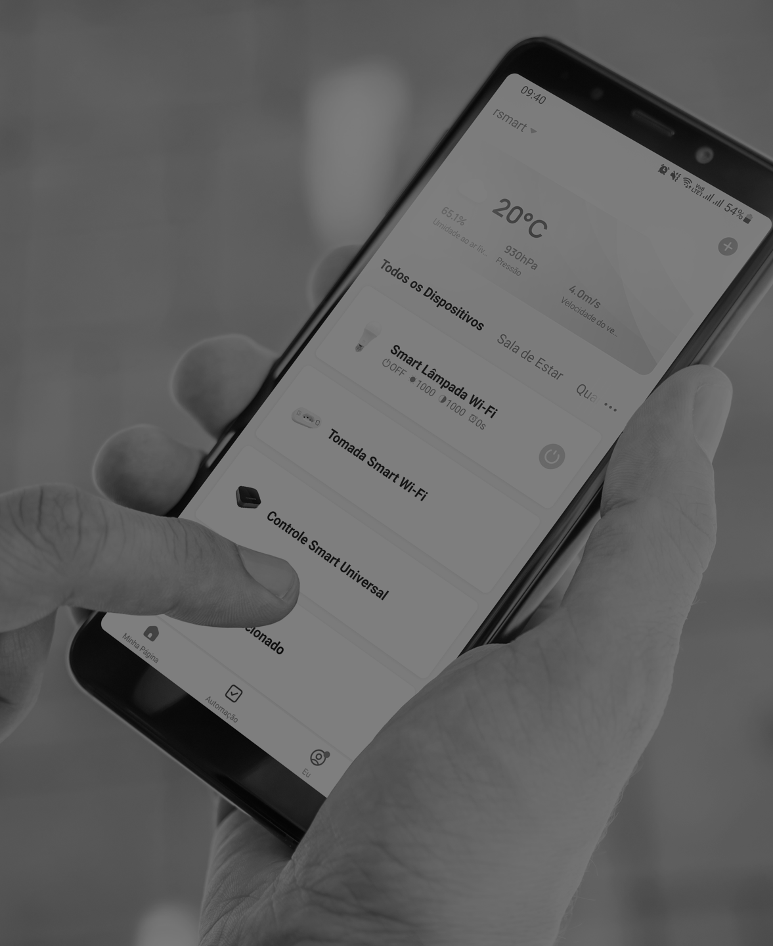

Brand from the Rcell group aimed at IoT solutions, it is a line of intelligent products aimed at home automation.
Our goal is to provide users with cutting-edge technology combined with convenience and ease of use, through the development of innovative, affordable products
and demonstrate that
technological innovations are
available to everyone for
improve your quality of life.

Slide 20
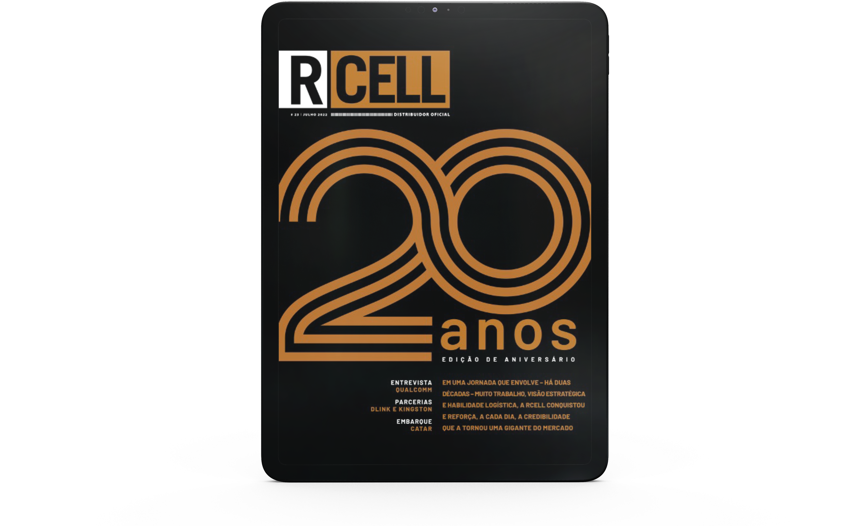
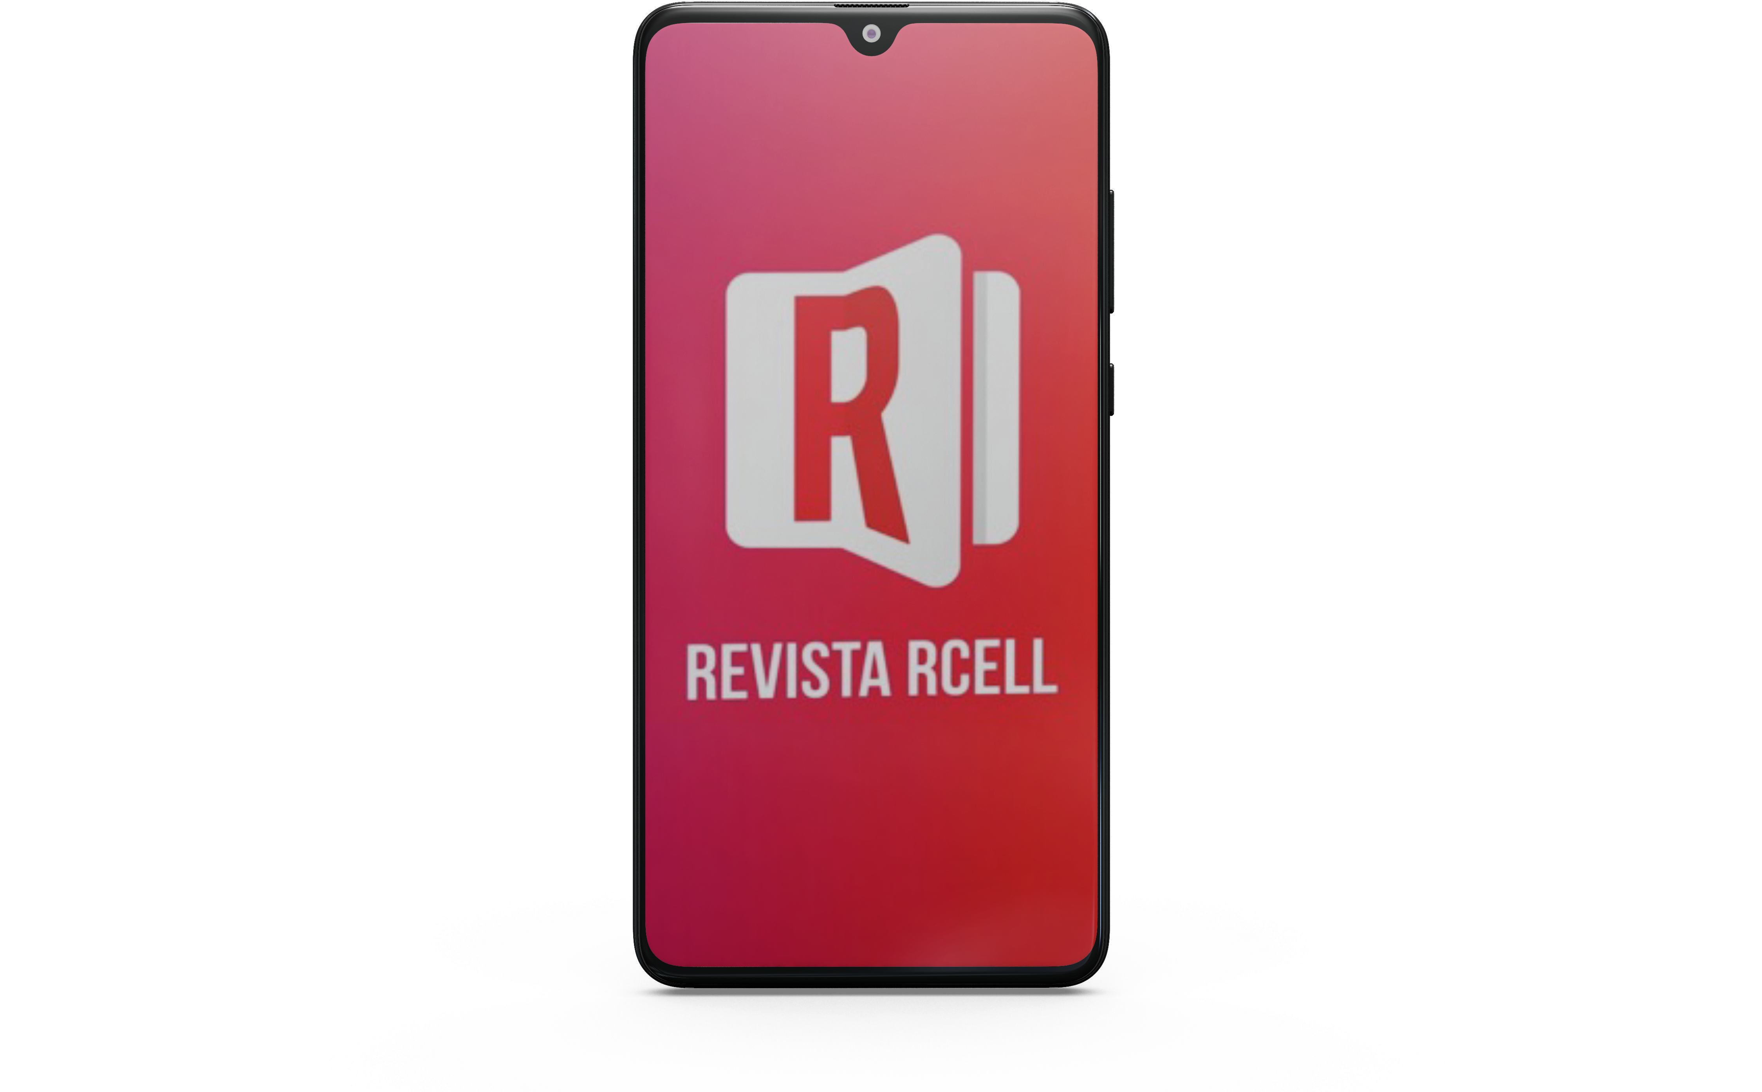
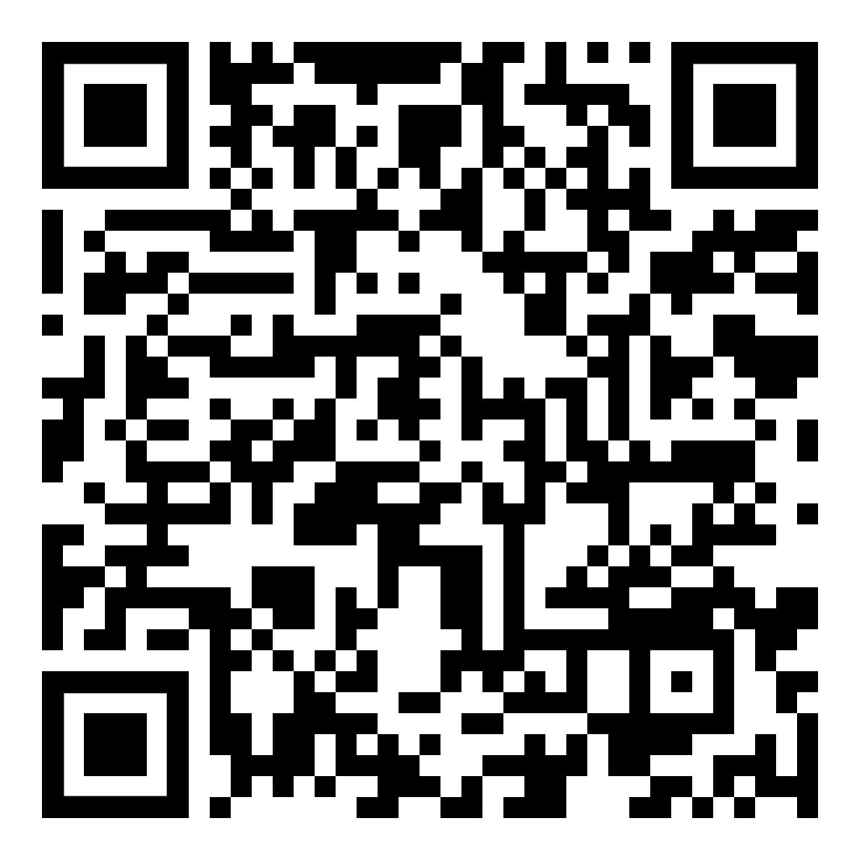
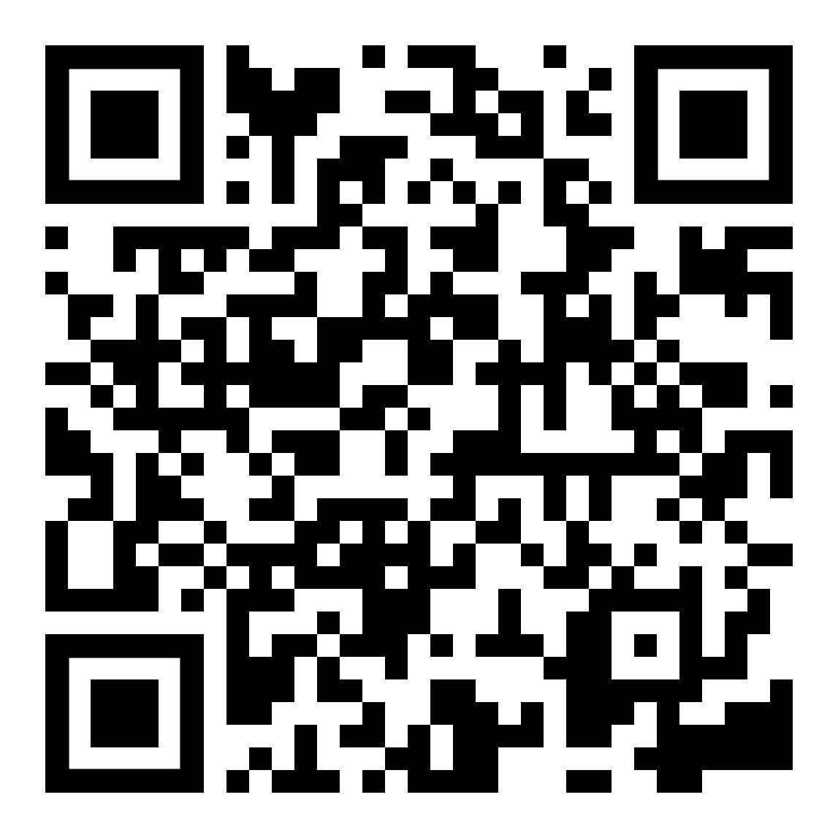


Rcell Magazine
Multiplatform content, in physical and digital media, exclusive content with articles, interviews, information, launches and comparative table of products.
Access Rcell Magazine on your computer, cell phone
or tablet from anywhere, or get
the printed version!
SCAN THE QRCODE AND DOWNLOAD THE APP

Slide 21
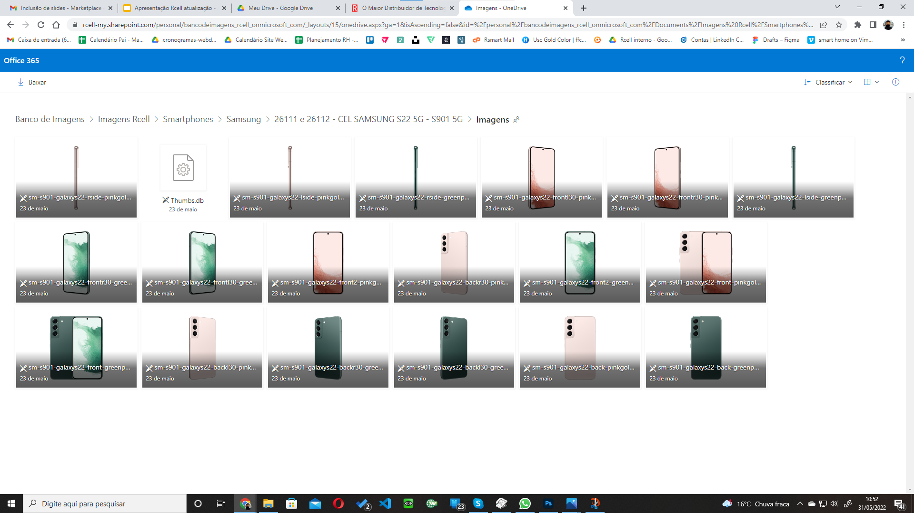
Image
Bank
Electro,
smartphones,
Accessories,
smart home,
Games,
Computing
and much more!
Available with high quality images of products ready to be used to promote your customers.

Slide 22
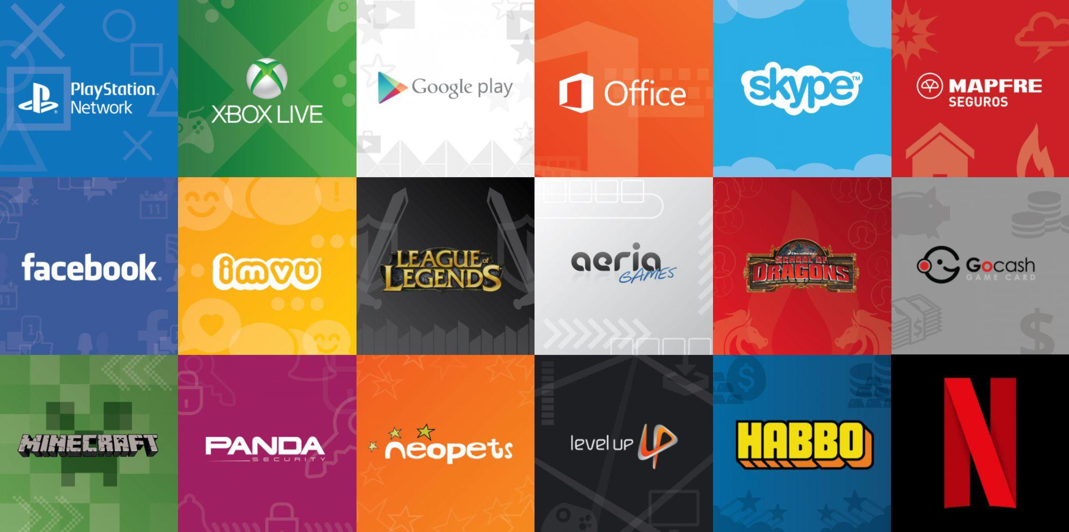

Digital Contents
Digital Gift Cards expanding portfolio options, profit performance without spending on space, transport and guarantee.

Slide 23


H3RO is a business unit focused on products and content developed
by gamers for gamers.
The gaming market is one of the most promising in Brazil. Currently, 74.5%
of Brazilians play electronic games and the market has already generated more than US$ 190 billion worldwide.
Rcell seeks, with H3RO, to reach the top
in the gamer segment, being recognized as the largest distributor in the sector.

Slide 24











Webfones is a brand of the Rcell group; It is the largest portal specialized in Telephony and Games in Brazil and incorporates the categories of IT, Electronics, Portable Appliances, Smarthome and others. Always with news from the national and global market with the best brands, a broad portfolio and the best shopping experience.
Prizes
Official Stores
2017 a 2021

Slide 25











Launched in the second half of 2020,
the Web Mercadinho brand created in partnership
with Mercado Livre is focused on supermarket products. In 2021 he became the 3P Main Seller of
Mercado Livre Supermarket category.
Revenue above R$34 Million in the first half of 2024
More than 500,000 orders placed
More than 850,000 products sold
We currently have more than 32 official stores from major brands in the industry that use our structure and algorithm, such as P&G, Heinz, Nivea, Bauducco, Unilever, Barilla, Andorinha, Colgate, Ambev and many others.

Slide 26

Thank You.

